Slide 1
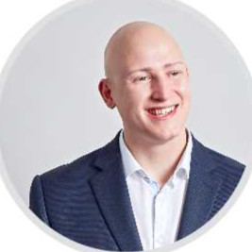
DOMINIC GOOCH
Data Analyst | Data Scientist
Data Analyst who completed the Data Analytics Career Accelerator course with the London School of Economics.
Knowledge and understanding of how to utilise Excel, Tableau, SQL, Python and R to provide interesting and actionable insights.

Slide 2


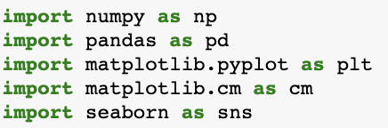
Key Projects:
NHS Study
Diagnostic Analysis
Utilised Python to investigate low or missed appointments across NHS services
Sales Data
Predictive Analysis
Exploited Python and R to analyse toy company's sales data
Built linear and mlr models
k-means clustering
Natural Language Processing
Employer Project – Thoughtworks / TFL
Group project
Employed skills learnt over the course to provide recommendations on how to increase cycling uptake in London

Slide 3
NHS Project:
NHS Study
Diagnostic Analysis
Utilised Python to investigate low or missed appointments across NHS services
Analysed patterns and trends in the data to identify causes of missed appointments
Provided recommendations based on the diagnostic analysis

Slide 4
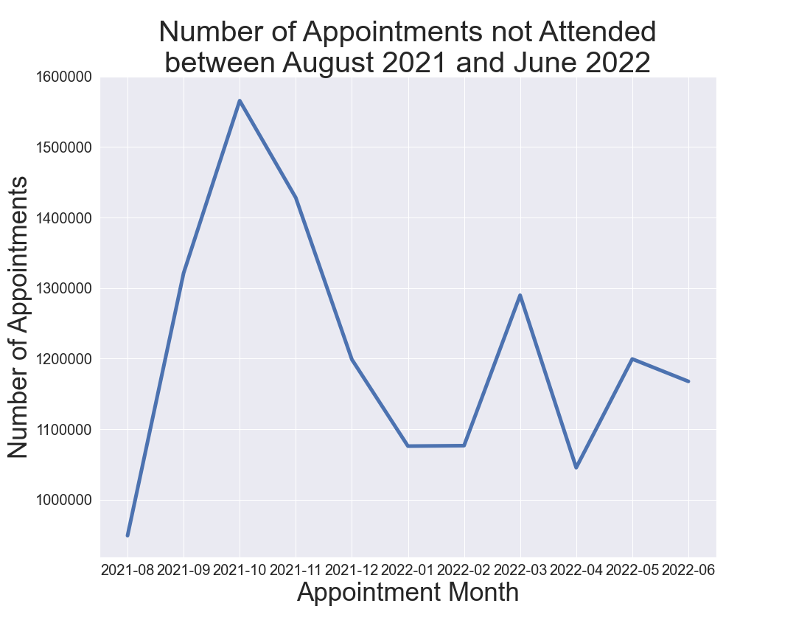
NHS Study:
Using Python to diagnose causes:
The key element of this project was to investigate missed NHS appointments.
First analysed what period, from the data provided, saw the highest number of missed appointments.
Can see the large spike rising from August 2021 and peaking in October 2021 as well as a smaller spike in between February and March 2022.
The next step was to look at different appointment factors to understand the cause.

Slide 5
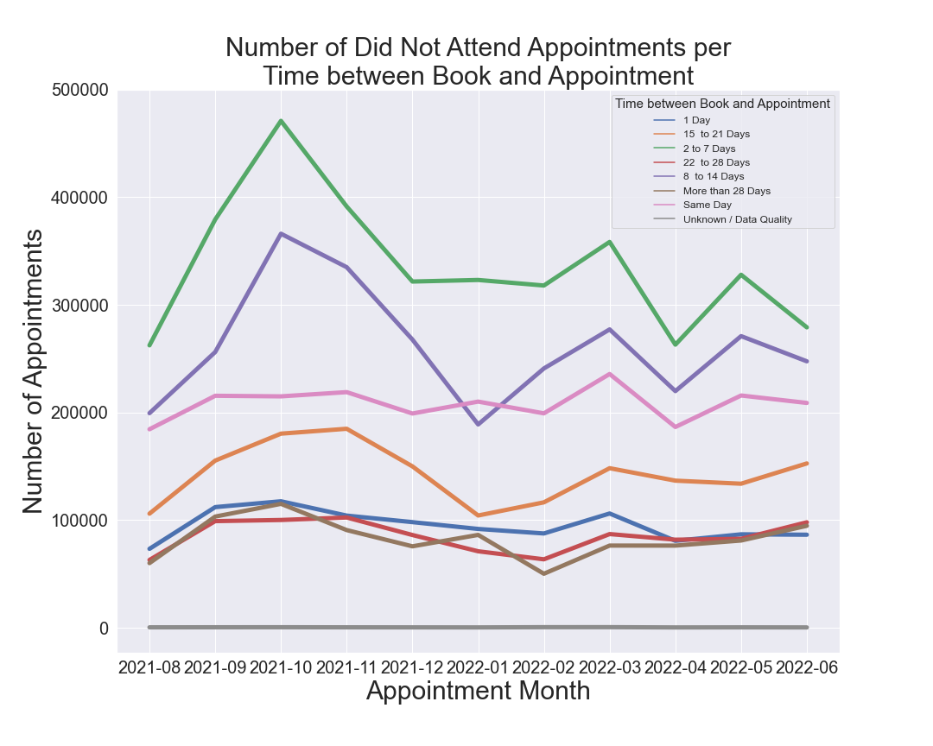
NHS Study:
Found that appointments with a Time between Book and Appointment of ‘2 to 7 days’ and ‘8 to 14 days’ contributed significantly to missed appointments.
Why is this? The likely cause behind a lot of these missed appointments is that if you feel ill you would want a same-day or next-day appointment. Once these appointments are booked you are offered an appointment with a longer time between book and appointment, after which time the symptoms have calmed down.
This “cause” would suggest these are GP appointments. Therefore, investigated Healthcare Professional Type for ‘2 to 7’ and ‘8 to 14’ appointments.

Slide 6
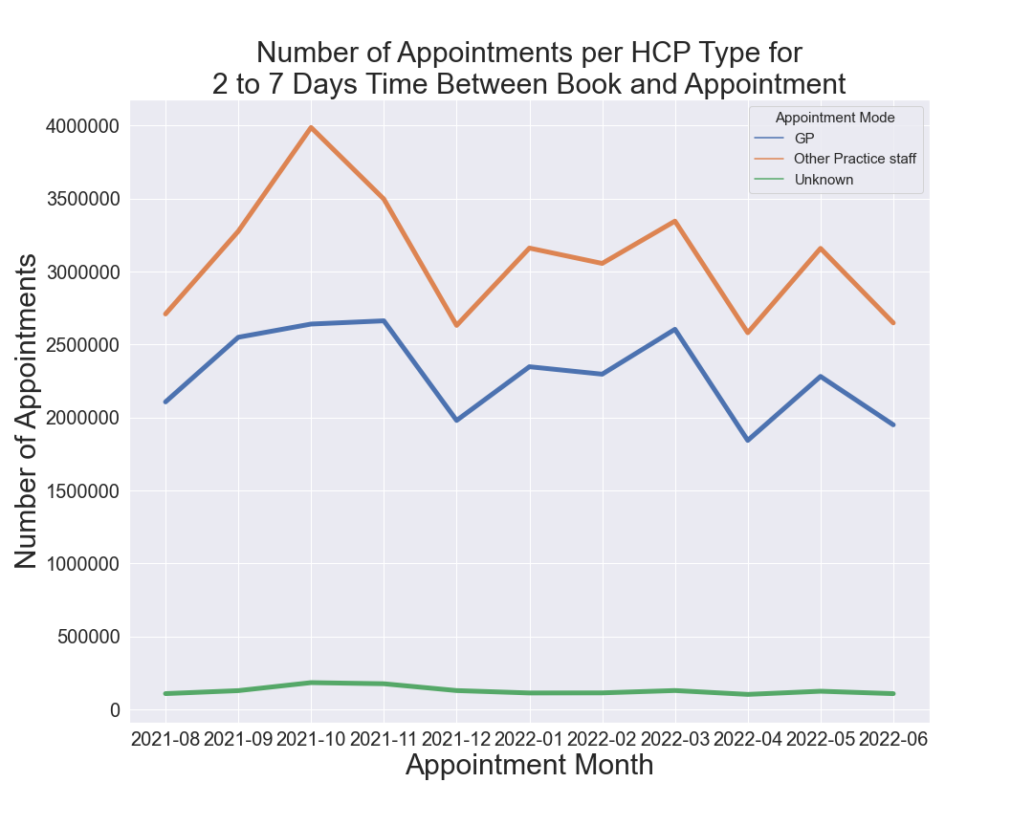
NHS Study:
With both ‘2 to 7 days’ (seen on the left) and ‘8 to 14 days’ found that ‘Other Practice Staff’ was the Health Care Professional (HCP) Type responsible for the most appointments.
The shape of the line in both instances also follows the same pattern we have seen for did not attend appointments.
Suggests the HCP Type offered to patients could be the root cause behind missed appointments.

Slide 7
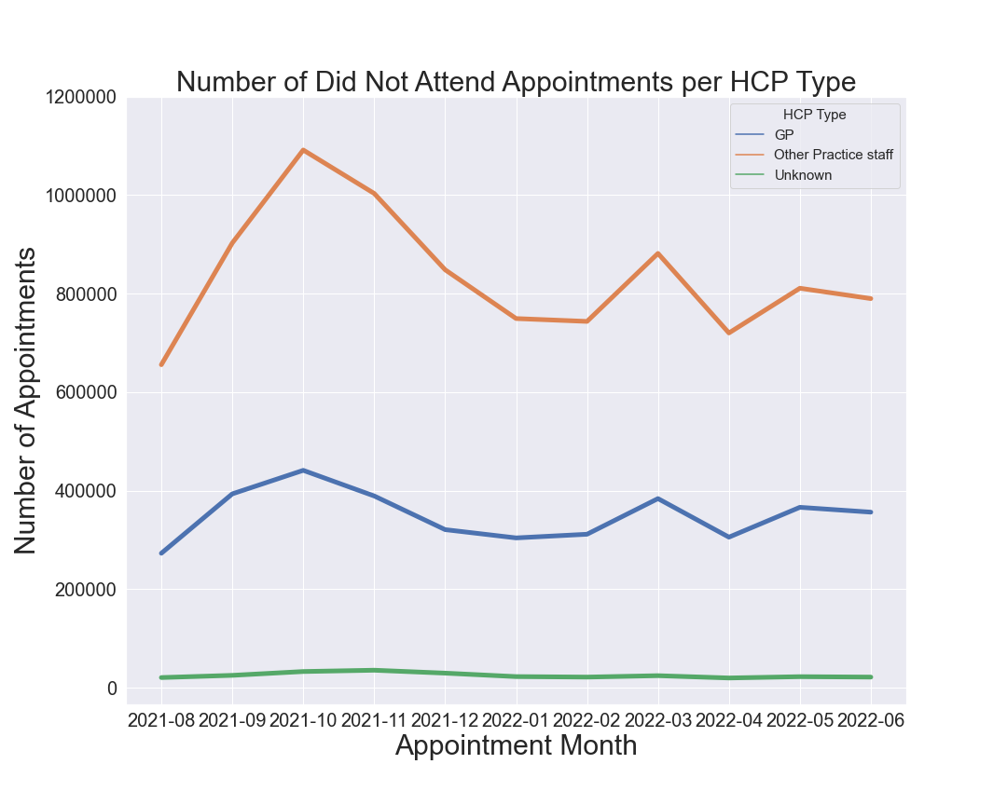
NHS Study:
Can see that Other Practice Staff contributes significantly more to the number of Did not Attend Appointments compared to the other HCP Types.
In the wider analysis, Other Practice Staff services are allocated a similar number of appointments as the GP service.
Recommendations from this project focused on further research as to why patients are not attending Other Practice Staff appointments.
Is it due to poor services? Not trusting a third-party provider?

Slide 8
Sales Project:
Sales Data
Predictive Analysis
Exploited Python and R to analyse toy company's sales data
Built linear and mlr models to determine the significance of variables and produce predictive values
k-means clustering to identify target customers
Natural Language Processing and polarity scores of product reviews

Slide 9
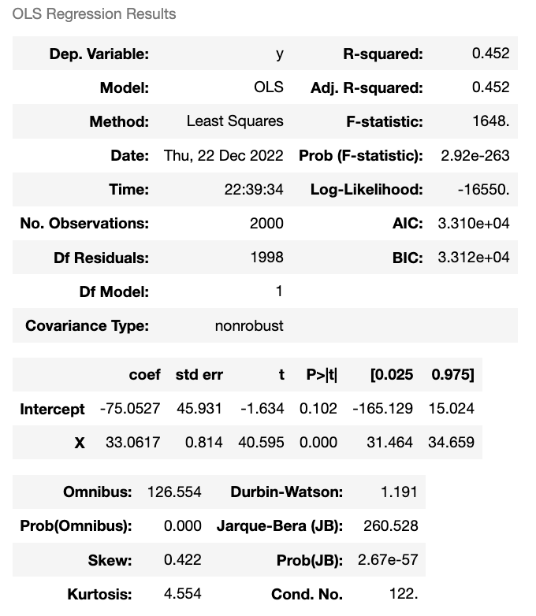
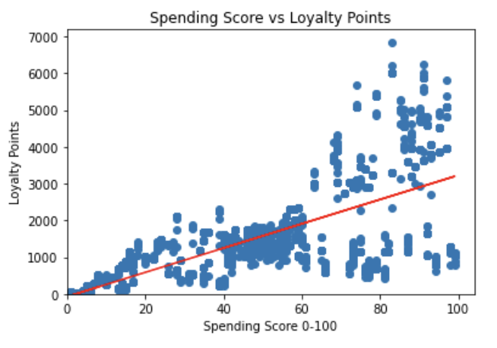
Sales Analysis:
Using Python to predict, cluster & Natural Language Processing:
Spending vs Loyalty
The first part of this project was to build three linear regression models plotting spending, remuneration and age against loyalty points.
The left table shows the results of spending vs loyalty which produced the strongest R-Squared score of 0.452. Spending score explains 45.2% of the variation in loyalty points
It also produced a Prob F-statistic / p-value which is lower than our significance level of 0.05, therefore meaning the variable is significant.

Slide 10
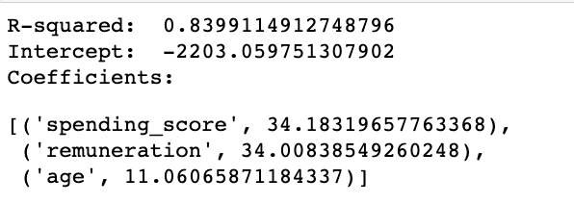
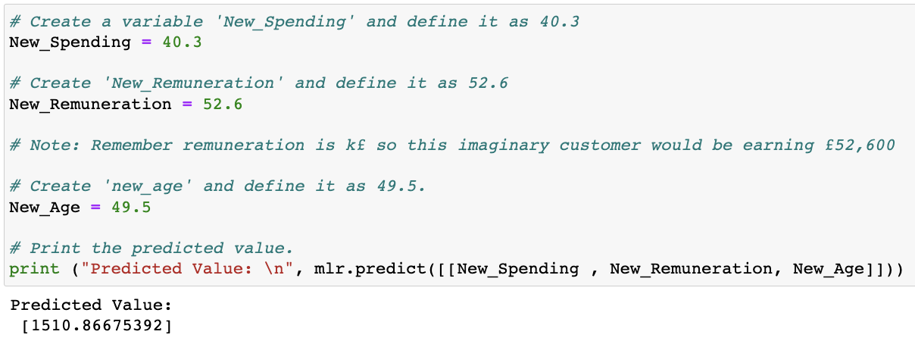
Sales Analysis:
After building linear regression models went on to build multivariate linear regression (MLR) models using two and three variables vs loyalty points.
The three-variable model of spending, remuneration and age vs loyalty points produced the strongest r-squared score.
Can see we are able to predict future customers loyalty points based on the values of these three metrics.
Given we have an R-squared of 0.84 we can be fairly confident that a customer with these values would have near to the predicted loyalty points.
Spending, Remuneration & Age

Slide 11
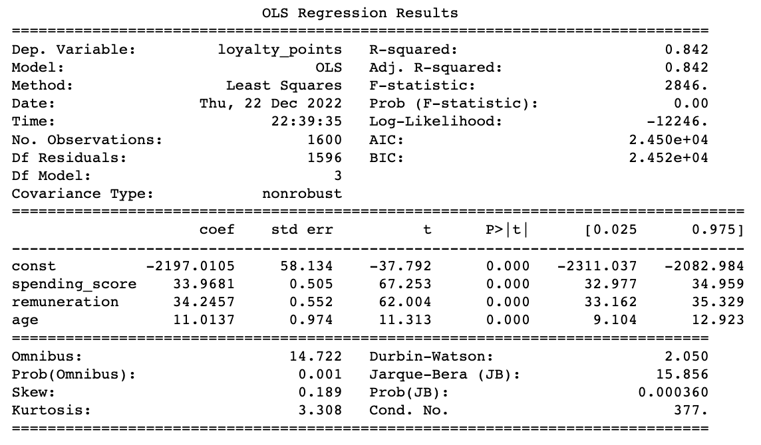
Sales Analysis:
Then ran a test and train set with an 80:20 split, using a random state of 42. The results of which can be seen on the left.
Here we pay attention to the adj. r-squared which penalises if the model is too complex. Can see that our adj. R-squared is the same as the R-squared being 0.842, so there isn’t an issue with complexity.
Also want to pay attention to the P>|t| score for each variable. All variables score 0.00 which is lower than our significance level of 0.05 stating all three variables are significant.
Spending, Remuneration & Age

Slide 12
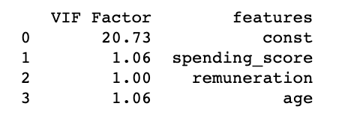

Sales Analysis:
After building the model then tested for multicollinearity between the three variables. If there is no collinear relationship between variables the score will be 1. Scores range from 1 to infinity. Can see each variable has a VIF of 1.06 indicating a very slight collinear relationship but not significant enough to worry about.
Also, tested the Mean Absolute Error (MAE) and Mean Square Error (MSE). Ideally, these scores would equal or be close to 0 which indicated a perfect model.
Whilst the scores are a long way from 0 they are lower than scores of any other MLR model.
Spending, Remuneration & Age

Slide 13
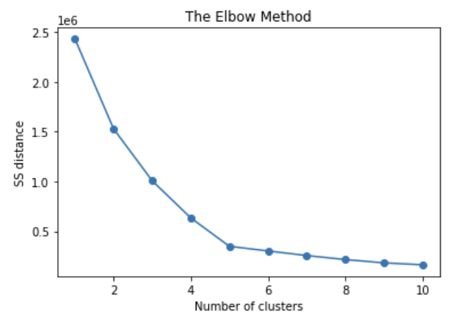
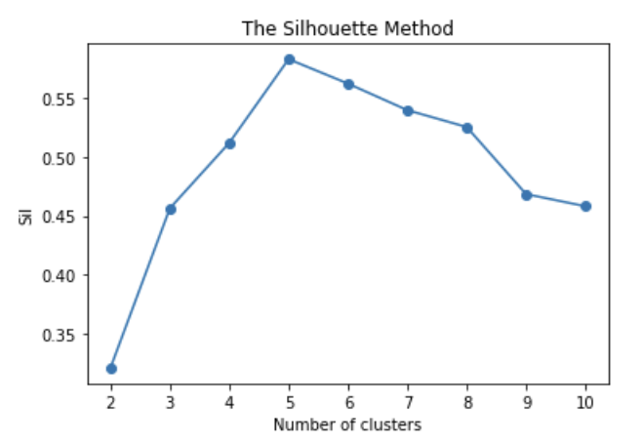
Sales Analysis:
Next step of the project was to identify customers the client could target better. To do this we clustered the customers.
Used the Elbow and Silhouette method to determine the optimum number of clusters.
For the Elbow we want to look where the line kinks and creates an ‘elbow’. For the Silhouette was want to choose where the line peaks, striking a balance been the Sil score and number of clusters.
In both instances we can see that 5 clusters is the optimum number.
K-means clustering

Slide 14
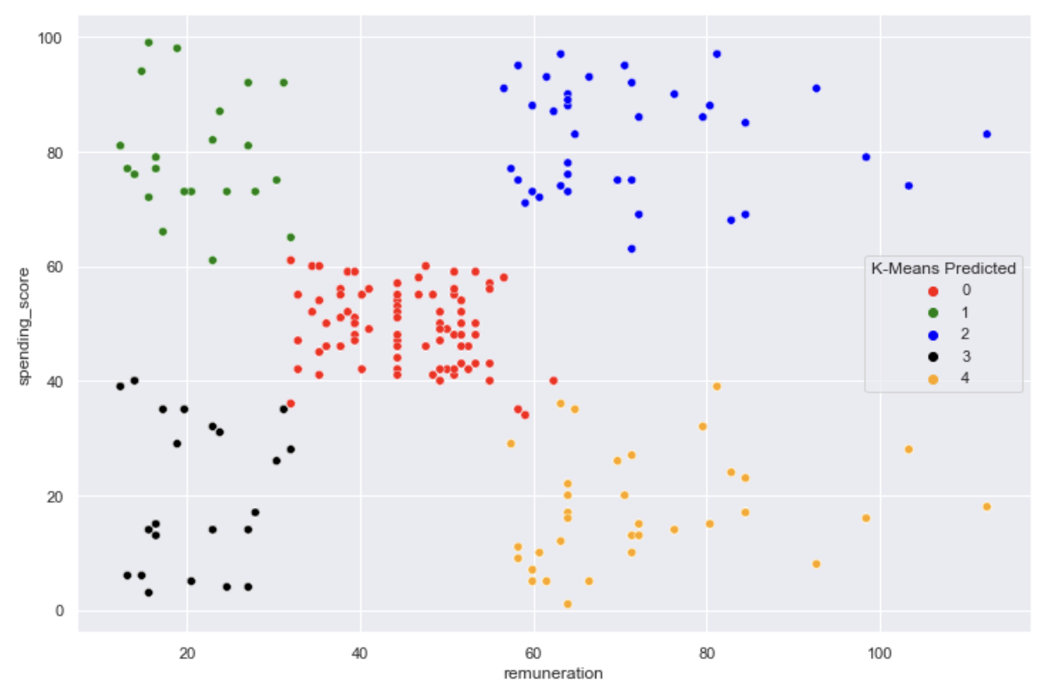
Sales Analysis:
Once the number of clusters has been determined can group customers based on their spending score and remuneration.
Can see the customers who have the lower spending score and therefore those to target, being clusters 3 and 4.
Cluster 4 should be the customers the client should particularly target. They are among those with the highest remuneration and therefore higher disposable income and thus the capacity to spend with the client.
K-means clustering

Slide 15
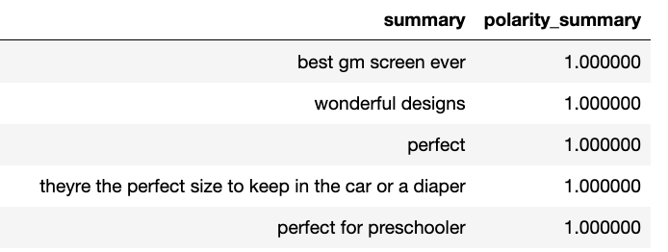
Sales Analysis:
The key part of the NLP analysis was to identify information which could then be utilised in future marketing campaigns.
On the left are the top five summaries, taken from a list of 20, which have the highest polarity score.
The recommendation to the client would be to look further into which products consistently receive reviews and summaries with high polarity scores.
The client should then look to increase the marketing of these products, especially on those that have a lower sales record but are performing well with customers.
Natural Language Processing (NLP) & Polarity Scores

Slide 16
NHS Project:
Employer Project – Thoughtworks / TFL
Group project
Employed skills learnt over the course to provide recommendations on how to increase cycling uptake in London
Personal analysis focused on Earnings, Mini Hollands and ethnic make up of London boroughs

Slide 17
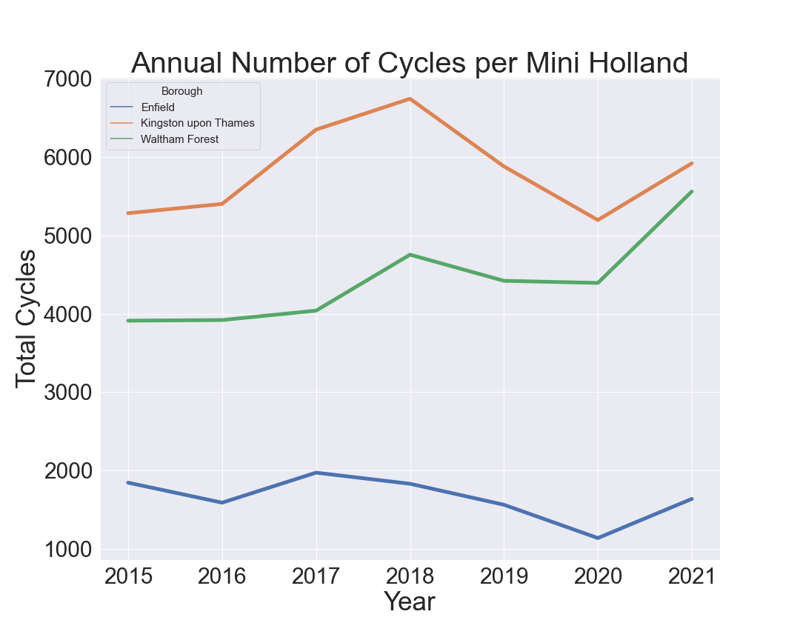
TFL London:
One of the central parts of my analysis was to look at the London Boroughs which took part in the Mini Holland govt initiative. This chimed with some infrastructure analysis another group member completed. Mini Hollands boroughs received significant investment in improving cycling infrastructure such as segregated cycling lanes.
Can see that two of the three Mini Holland boroughs saw a positive increase in cycling numbers pre Covid-19 and a healthy return post-pandemic.
From this initial analysis, I further analysed Waltham Forest.
Mini Hollands

Slide 18
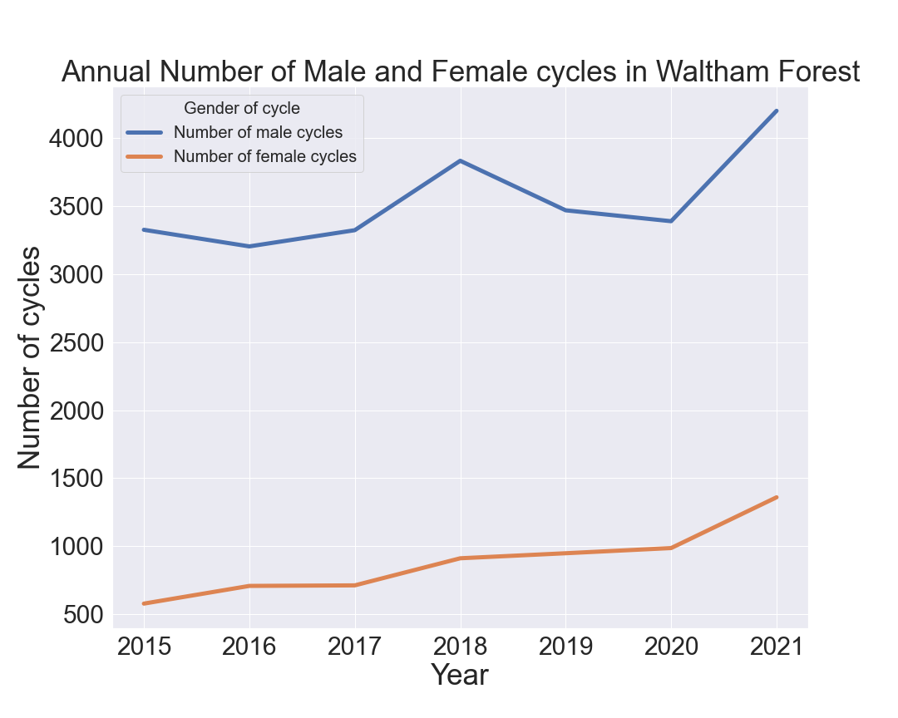
TFL London:
Looking at Waltham Forest further we saw a positive rise in both male and female cycling numbers.
Female cycling numbers are important as they are significantly lower than males in every instance across all boroughs.
This positive rise in female cycling numbers is encouraging and shows the benefit of introducing Mini Hollands.
In some of our wider analysis and research of external sources, we found that safety was a primary concern for female cyclists. Therefore, the Waltham Forest study shows how investing in infrastructure can increase female cycling rates.
Mini Hollands: Mini Hollands

Slide 19
TFL London:
Looking at Waltham Forest further we saw a positive rise in both male and female cycling numbers.
Female cycling numbers are important as they are significantly lower than males in every instance across all boroughs.
This positive rise in female cycling numbers is encouraging and shows the benefit of introducing Mini Hollands.
In some of our wider analysis and research of external sources, we found that safety was a primary concern for female cyclists. Therefore, the Waltham Forest study shows how investing in infrastructure can increase female cycling rates.
Mini Hollands: Waltham Forest

Slide 20
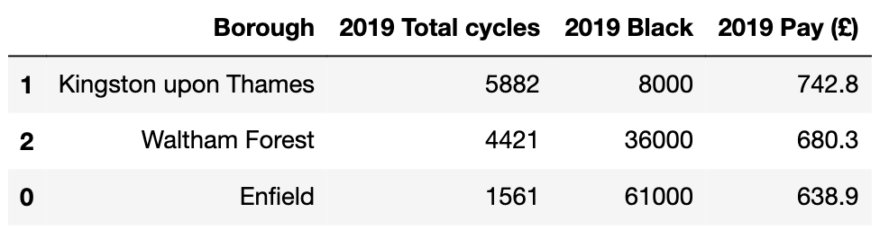
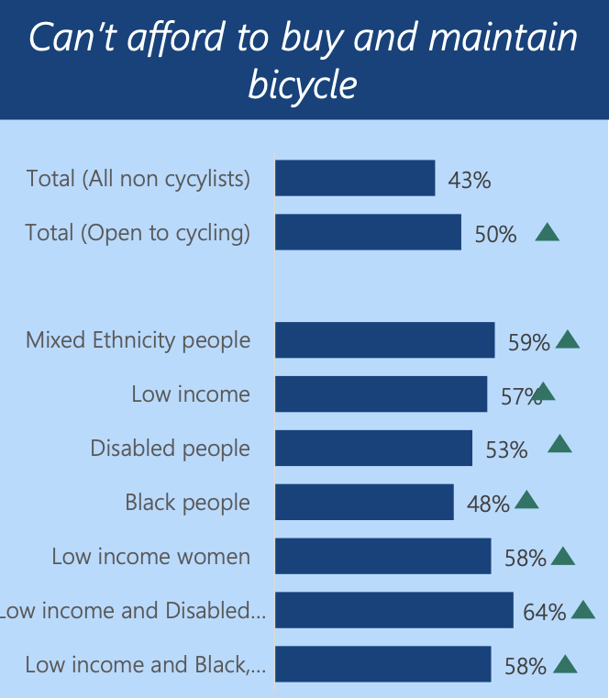
We also recognised that one of the Mini Hollands wasn’t performing as well being Enfield. Conducted some further research into the ethnic makeup of each Mini Holland borough. I found that Enfield had a higher black population compared to other boroughs. Additionally, I also found the average weekly full-time earnings were lower than the other boroughs.
A study conducted by TFL found that access to a bike was a major barrier for ethnic groups. This could suggest the poor performance of Enfield as its residents are unable to own / access bikes.
Our recommendation was to offer an initiative to increase access to bikes in Enfield & other low-income boroughs.
TFL London:
Mini Hollands: Enfield

Slide 21
GET IN
TOUCH
Email: dominicgooch@Hotmail.co.uk
Mobile: 0750 549 3557

